Slide 1
MAIN PROJECT OVERVIEW
Page 6 of 19

Slide 2
ZipClip: Edit Less, Post More
Convert your videos into short-form content
PRESENTED BY: ABHIJITH R ANIRUDH KB JESVIN J
GUIDE:
Mrs. Sabitha Raju
Head of the Department, CG
Page 6 of 19

Slide 3
PROBLEM STATEMENT
Long-form videos often hide the most engaging moments, but finding them manually is slow and exhausting.
Many creators lack the time, skills, or resources to transform raw footage into short, polished clips.
Existing editing tools are either too complex or too expensive for everyday users.
Missing the right highlights means lost audience attention and reduced impact on short-form platforms.
Page 6 of 19

Slide 4
OBJECTIVE
Automate the process of extracting highlights from long-form videos using AI-based multi-modal analysis.
Provide an interactive platform for creators to preview, refine, and export clips optimized for YouTube Shorts, Instagram Reels, and TikTok.
Enable easy content creation by allowing users to generate story reels from their own photos with AI-driven transitions, captions, and music.
Ensure clips preserve narrative flow and emotional impact, making short-form content more engaging and platform-ready.
Page 6 of 19

Slide 5
OBJECTIVE
Support platform-specific formatting so clips are instantly ready for YouTube Shorts, Instagram Reels, and TikTok.
Incorporate natural language prompts (e.g., “show all funny parts”) for personalized highlight generation.
Ensure scalability with a modular AI design that allows adding new agents for education, sports, or event videos.
Provide a foundation for future enhancements like auto-music selection, subtitles, and multi-language support.
Page 6 of 19

Slide 6
SCOPE
AI-Powered Video Summarization: Automatically analyze long-form videos to detect scenes, emotions, and key moments, producing short-form highlights.
Interactive Content Creation: Provide an intuitive dashboard where users can preview, fine-tune, and export clips optimized for YouTube Shorts, Instagram Reels, and TikTok.
Story Reel Generation: Allow users to upload personal photos and create AI-driven reels with captions, transitions, and music.
Scalable & Extensible Design: Support modular AI agents, making the system adaptable for future use cases like sports highlights, educational content, and event coverage.
Page 6 of 19

Slide 7
INTRODUCTION
Long-form videos are time-consuming to edit, and the most engaging moments often remain hidden.
Creators, educators, and marketers spend hours manually cutting clips, relying on costly or complex editing tools.
Missed highlights reduce audience engagement and limit reach on short-form platforms.
The AI-driven ZipClip system automates highlight extraction and story reel creation, making content production faster, smarter, and more accessible.
Page 6 of 19

Slide 8
SURVEY
LITERATURE
REF
[1]
[2]
TITLE
X. Zhou, J. Smith, “Video summarization using deep learning techniques: a comprehensive review,” ACM Computing Surveys, vol. 56, no. 3, pp. 44:1–44:39, 2023.
Y. Chen, L. Patel, “Video summarization for event-centric videos,” IEEE TNNLS, vol. 34, no. 7,
pp. 1126–1138, 2023.
KEY FEATURES
Deep learning models (CNN, LSTM).
Covers supervised & unsupervised.
Scalable for user/creator platforms.
Event-driven summarization. Fusion multimodal features. Designed for highlights extraction and context.
GAPS IDENTIFIED
Limited real-time evaluation. Bias in datasets.
Not tested on very short-form content.
Limited domain adaptation.
Page 6 of 19

Slide 9
REF
[3]
[4]
TITLE
M. Gupta, et al, “AI-driven video summarization for optimizing content search and retrieval efficiency,” Sci Rep, vol. 15, no. 2, pp. 141–150,
2025.
Q. Li, A. Tang, “Video summarization via knowledge-aware multimodal networks,” Inf Fus, vol. 99, pp. 191–200, 2024.
KEY FEATURES
Spatial & temporal summarization.
Optimized for retrieval. Automation for content creators.
Knowledge-driven multimodal fusion.
Robust highlight extraction. Multi-agent inputs.
GAPS IDENTIFIED
Focus on search, not platform deployment. Evaluation on YouTube only.
Computational cost. Sparse real-user studies.
Page 6 of 19

Slide 10
REF
[5]
[6]
TITLE
Y. Wang, J. Lee, “Zero-shot scene change detection,” in AAAI Conf Artif Intell, ACM, vol. 39, no. 3, pp. 32253–32260, 2024.
W. Fan, C. Liu, “Scene Object Change Detection and Fine-Grained Target Recognition,” ACM TMM, vol. 13, no. 2, pp. 1012–1024, 2024.
KEY FEATURES
No-training needed. Effective boundary finding. Feature differencing.
Pixel-level object/scene change. High precision.
Fine-grained segmentation.
GAPS IDENTIFIED
May miss subtle transitions. Limited evaluation on user videos.
Computationally expensive. Not robust to occlusion.

Slide 11
REF
[7]
[8]
TITLE
C. Chang, Z. Liu, “Advances in Video Emotion Recognition: Challenges and Progress,” IEEE Trans Affect Comput, vol. 16, no. 4,
pp. 360–373, 2025.
F. Silva, R. Rao, “Multimodal Emotion Recognition with Deep Learning,” Inf Fusion, vol. 79, pp. 33–44, 2024.
KEY FEATURES
Multimodal fusion. Temporal emotion modeling. Robustness benchmarks.
Deep learning fusion for video/audio/text.
Cross-modal signals. Modular architectures.
GAPS IDENTIFIED
Most tests academic datasets.
Limited cross-platform evaluation.
Dataset limitations. Not tested for platform-specific optimization.

Slide 12
REF
[9]
[10]
TITLE
D. Wu, S. Zhou, “Applications and Reliability of Automatic Facial Emotion Recognition in Video Analysis,” ACM TMM, vol. 24, no. 5,
pp. 452–463, 2024.
T. Park, S. Kim, “Emotion Recognition using multi-modal data and self-supervised learning,” ACM TMM, vol. 31, no. 2, pp. 339–347,
2024.
KEY FEATURES
Face-based emotion detection. Reliability analysis.
Automated annotation system.
Combines multimodal & self-supervised.
Improved scaling for real video. Quality benchmarks.
GAPS IDENTIFIED
Weak performance on occluded faces.
No cross-cultural study.
Large data demand.
Not optimized for live feeds.

Slide 13
REF
[11]
[12]
TITLE
S. Agarwal, H. Singh, “Real Time Emotion Recognition Using Image Classification,” ACM, ICIP, pp. 276–285, 2023.
H. Gu, S. Petrangeli and V. Swaminathan, "SumBot: Summarize Videos Like a Human," 2020 IEEE International Symposium on Multimedia (ISM), Naples, Italy, 2020, pp. 210-217.
KEY FEATURES
Real-time emotion detection. Dashboard integration.
Fast response systems.
• Shot splitting; Inception/CNN features.
• MDP/IRL: MaxEnt reward; policy iteration.
• 70.65 F-score; mimics experts.
GAPS IDENTIFIED
Focus on static images. Needs extension for sequence emotion.
• Linear reward; semi-structured only.
• Soccer-focused; few demos risk.

Slide 14
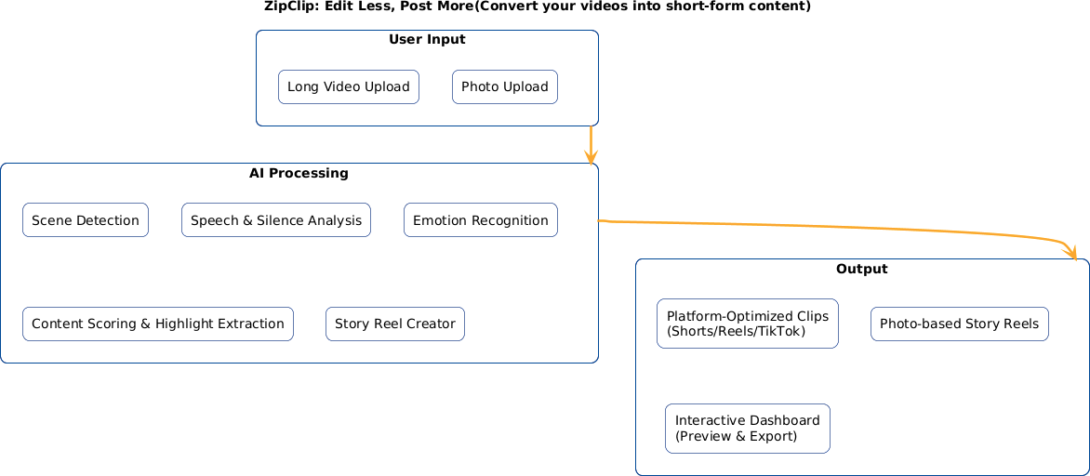
PROPOSED METHOD

Slide 15
CONCLUSION
ZipClip simplifies content creation by automatically extracting highlights from long videos and generating engaging story reels.
It reduces dependence on complex, costly editing tools by offering AI-based scene detection, emotion analysis, and smart clip generation.
The system empowers creators, educators, and marketers with quick, structured, and platform-ready outputs tailored for Shorts, Reels, and TikTok.
With scalability and modular design, ZipClip sets the foundation for future enhancements like auto-music selection, subtitles, and multilingual support.

Slide 16
REFERENCE
X. Zhou, J. Smith, “Video summarization using deep learning techniques: a comprehensive review,” ACM Computing Surveys, vol. 56, no. 3, pp. 44:1–44:39, 2023.
Y. Chen, L. Patel, “Video summarization for event-centric videos,” IEEE TNNLS, vol. 34, no. 7, pp. 1126–1138, 2023.
M. Gupta, et al, “AI-driven video summarization for optimizing content search and retrieval efficiency,” Sci Rep, vol. 15, no. 2, pp. 141–150, 2025.
Q. Li, A. Tang, “Video summarization via knowledge-aware multimodal networks,” Inf Fus, vol. 99, pp. 191–200, 2024.

Slide 17
REFERENCE
Y. Wang, J. Lee, “Zero-shot scene change detection,” in AAAI Conf Artif Intell, ACM, vol. 39, no. 3, pp. 32253–32260, 2024.
W. Fan, C. Liu, “Scene Object Change Detection and Fine-Grained Target Recognition,” ACM TMM, vol. 13, no. 2, pp. 1012–1024, 2024.
C. Chang, Z. Liu, “Advances in Video Emotion Recognition: Challenges and Progress,” IEEE Trans Affect Comput, vol. 16, no. 4, pp. 360–373, 2025.
F. Silva, R. Rao, “Multimodal Emotion Recognition with Deep Learning,” Inf Fusion, vol. 79, pp. 33–44, 2024.

Slide 18
REFERENCE
D. Wu, S. Zhou, “Applications and Reliability of Automatic Facial Emotion Recognition in Video Analysis,” ACM TMM, vol. 24, no. 5, pp. 452–463, 2024.
T. Park, S. Kim, “Emotion Recognition using multi-modal data and self-supervised learning,” ACM TMM, vol. 31, no. 2, pp. 339–347, 2024.
JS. Agarwal, H. Singh, “Real Time Emotion Recognition Using Image Classification,” ACM, ICIP, pp. 276–285, 2023.
H. Gu, S. Petrangeli and V. Swaminathan, "SumBot: Summarize Videos Like a Human," 2020 IEEE International Symposium on Multimedia (ISM), Naples, Italy, 2020, pp. 210-217.

Slide 19

THANK YOU

